Slide 1
SEIS744 IoT with Machine Learning
Shijun Yang

Slide 2
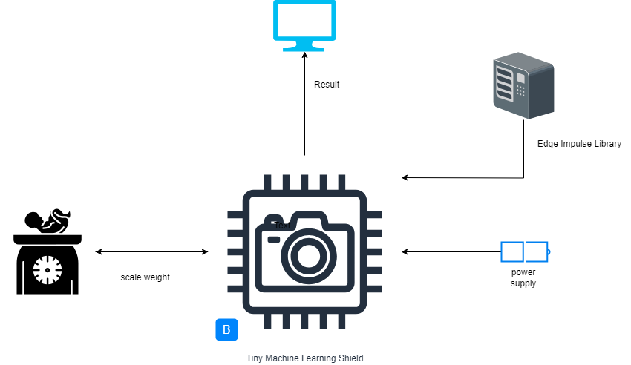
IDEA

Slide 3
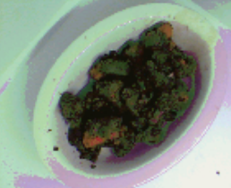
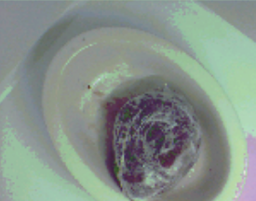
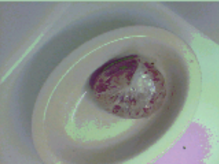
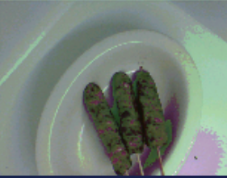
Pork rib beef fish sausages

Slide 4
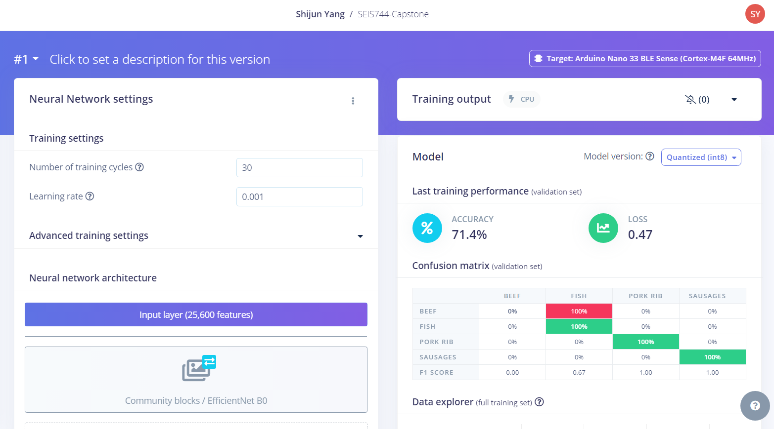

Slide 5
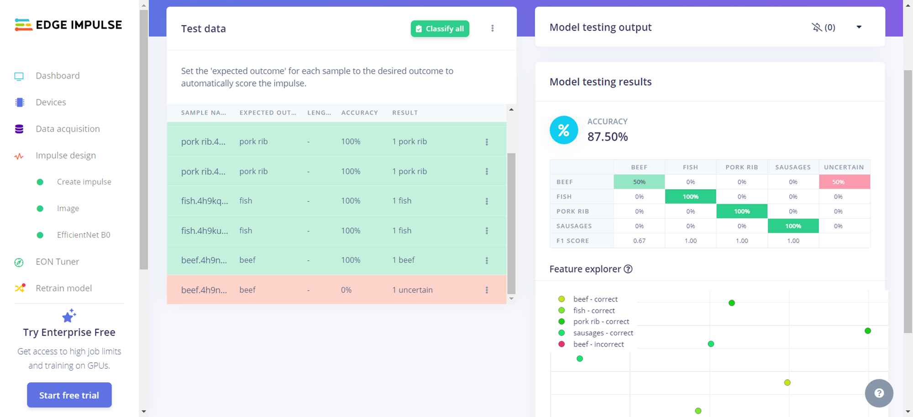

Slide 6
Future
1. Scale weight implementation
2. Another performance of output
3. Automated detection

